Slide 1
To calculate gravitational attraction between objects
Success Criteria
I can calculate gravitational attraction between objects
I can calculate acceleration due to gravity

Slide 2
To analyse gravitational attraction
Content Development
Fields are used in physics to represent non-contact forces
  Electric fields
  Magnetic fields
  Gravitational fields
In Year 12 Physics, we investigate all of these.
This lesson: we’ll look at how all objects with mass produce a gravitational field

Slide 3
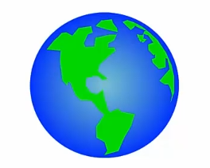
To analyse gravitational attraction
Content Development
A field is representation of the vectors that are acting over a certain region of space
A gravitational field is represented by a collection of arrows which show the direction of a gravitational force
Field lines:
  Direction = arrows
  Strength = density
  Any object with mass around the Earth is attracted to the Earth by gravity

Slide 4
To analyse gravitational attraction
Content Development
To draw a field, imagine you are an object that is affected by the force. Where would you be pulled?
  The lines at the surface of the Earth are closer spaced than the lines at a distance.
  Density of lines = Strength of field
  The further from the Earth you are, the weaker the effect of Earth’s gravity.

Slide 5
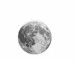
To analyse gravitational attraction
Content Development
Field lines:
  Direction = arrows
  Strength = density
  Gravity is stronger when objects have a greater mass.

Slide 6
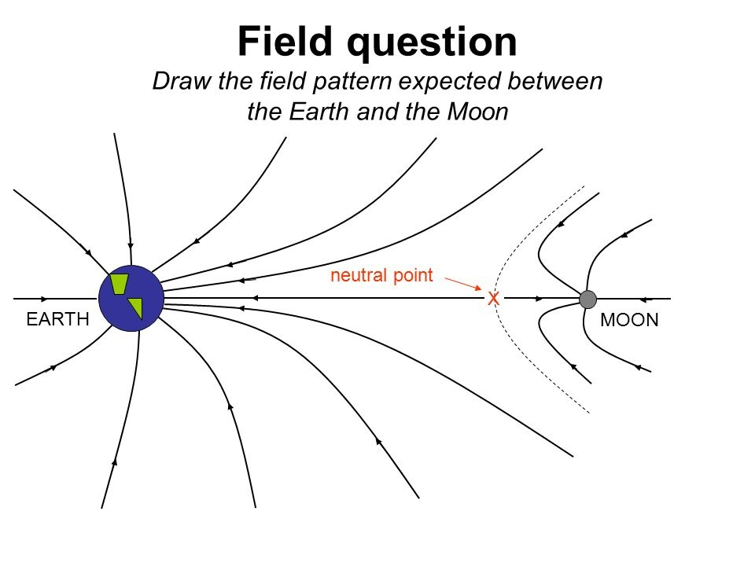
To analyse gravitational attraction
Content Development
Field lines:
  Direction = arrows
  Strength = density
  Gravity is stronger when objects have a greater mass.

Slide 7
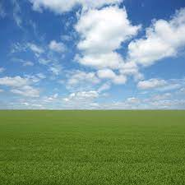
To analyse gravitational attraction
Content Development
  Note that on the surface of the Earth, the field can be represented as straight lines.
  The Earth is so large that any horizontal movement of the object is irrelevant.
  Field lines point straight down and are evenly spaced.

Slide 8
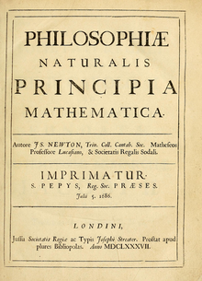

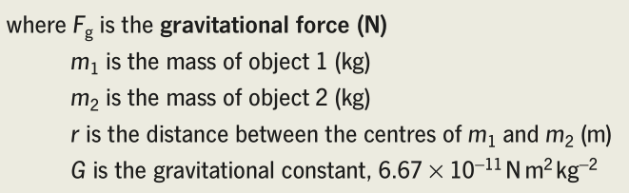
To analyse gravitational attraction
Content Development
  In 1667, Isaac Newton published the book Philosophiæ Naturalis Principia Mathematica which introduced the Law of universal gravitation.
  This was the first time in history that it was possible to scientifically explain the motion of the planets.
  Two bodies with mass attract each other with a force that is directly proportional to the product of their masses and inversely proportional to the square of the distance between them.

Slide 9
To analyse gravitational attraction
Content Development
  Calculate the force due to gravity of the Earth on a person on the surface of the Earth.
  Calculate the acceleration due to gravity.
Notes:
Mass of the earth = 5.97x10^24 kg
Radius of the earth = 6.37x10^6 m
Mass of person = 80kg
G = 6.67x10^-11 Nm^2kg^-2
Fg = 785 N
a = 9.81 m/s/s

Slide 10
To analyse gravitational attraction
Content Development
  Calculate the force due to gravity of the Earth on a person at the top of a 20-storey building
  (assume 3.5m per storey)
  Calculate the acceleration due to gravity.
Notes:
Mass of the earth = 5.97x10^24 kg
r= 6.37x10^6 m + (20*3.5) = 6370070m
Mass of person = 80kg
G = 6.67x10^-11 Nm^2kg^-2
Fg = 785 N
A = 9.81 m/s/s

Slide 11
To analyse gravitational attraction
Content Development
  Calculate the force due to gravity of the Earth on the Moon.
  Calculate the acceleration due to gravity.
Notes:
Mass of the earth = 5.97x10^24 kg
r= 6.37x10^6 m + (20*3.5) = 6370070m
Mass of moon = 7.35*10^22
G = 6.67x10^-11 Nm^2kg^-2
Fg = 1.98x10^20 N
F = ma
1.98x10^20 = 7.35*10^22 * a
a = 0.002694 m/s/s

Slide 12
To analyse gravitational attraction
Content Development
  Calculate the force due to gravity of the Earth on the Moon.
  Calculate the acceleration due to gravity.
  Assuming a perfectly circular orbit, calculate the number of days it takes for the Moon to orbit the Earth.
Notes:
Mass of the earth = 5.97x10^24 kg
r= 6.37x10^6 m + (20*3.5) = 6370070m
Mass of moon = 7.35*10^22
G = 6.67x10^-11 Nm^2kg^-2
Fg = 1.98x10^20 N
F = ma
1.98x10^20 = 7.35*10^22 * a
a = 0.002694 m/s/s
384000000m moon-earth distance (from data sheet)
Velocity (from centripetal force) = 1017m/s
T (from v = 2pi*r/T) = 2372229s = 27.46 days
This is similar to the reasoning used by Newton to deduce the law of gravitation!

Slide 13
To analyse gravitational attraction
Content Development
  Calculate the force due to gravity of the Moon on the Earth.
Notes:
Mass of the earth = 5.97x10^24 kg
r= 6.37x10^6 m + (20*3.5) = 6370070m
Mass of moon = 7.35*10^22
G = 6.67x10^-11 Nm^2kg^-2
Fg =1.98*10^20 N
This is the same magnitude but in a different direction. Newton’s 3rd Law

Slide 14
To analyse gravitational attraction
Content Development
  Note:
  The force of gravity of the Earth on the Moon is the same magnitude as the force of gravity of the Moon on the Earth.
  The gravitational force attracting two objects is symmetrical (Newton’s 3rd Law).
  But the resulting acceleration is not!
  The smaller mass with have the greater acceleration.

Slide 15

To analyse gravitational attraction
Content Development
  The gravitational field strength is defined as:
    The net force per unit mass caused by the gravitational field
    m = mass of the object you are studying
    M = mass of the object supplying the gravitational field in question
    This is equivalent to the acceleration that an object will undergo in that gravitational field.

Slide 16
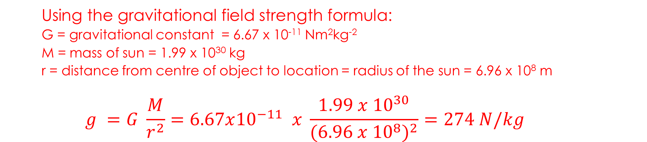
To analyse gravitational attraction
I do
  Calculate the gravitational field strength at the surface of the Sun.
  Using the gravitational field strength formula:
  G = gravitational constant = 6.67 x 10⁻¹¹ Nm²kg⁻²
  M = mass of sun = 1.99 x 10³⁰ kg
  r = distance from centre of object to location = radius of the sun = 6.96 x 10⁸ m
  $$g =G \frac{M}{r^{2}}=6.67x{10}^{−11} x \frac{1.99 x {10}^{30}}{{(6.96 x {10}^{8})}^{2}}=274 N/kg$$
Notes:
Mass of the Sun.....................................................MS = 1.99 × 10^30 kg
Mean radius of the Sun .........................................RS = 6.96 × 10^8 m
Newtonian constant of gravitation .........................G = 6.67 × 10-^11 N m2 kg-2
g= 274 N/kg

Slide 17
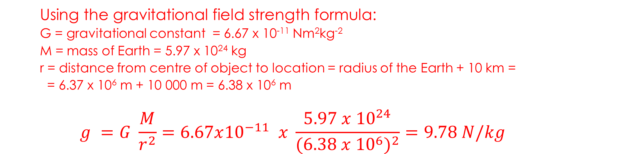
To analyse gravitational attraction
We do
  Calculate the gravitational field strength at 10 km above the surface of the Earth.
  Using the gravitational field strength formula:
  G = gravitational constant = 6.67 x 10⁻¹¹ Nm²kg⁻²
  M = mass of Earth = 5.97 x 10²⁴ kg
  r = distance from centre of object to location = radius of the Earth + 10 km =
  = 6.37 x 10⁶ m + 10 000 m = 6.38 x 10⁶ m
  $$g =G \frac{M}{r^{2}}=6.67x{10}^{−11} x \frac{5.97 x {10}^{24}}{{(6.38 x {10}^{6})}^{2}}=9.78 N/kg$$
Notes:
Mass of the Sun.....................................................MS = 1.99 × 10^30 kg
Mean radius of the Sun .........................................RS = 6.96 × 10^8 m
Newtonian constant of gravitation .........................G = 6.67 × 10-^11 N m2 kg-2
g= 274 N/kg

Slide 18
To analyse gravitational attraction
You do
  Calculate the gravitational field strength at 20 000 km above the surface of the Earth.
Remember: distance needs to be in metres!
Notes:
Mass of the Sun.....................................................MS = 1.99 × 10^30 kg
Mean radius of the Sun .........................................RS = 6.96 × 10^8 m
Newtonian constant of gravitation .........................G = 6.67 × 10-^11 N m2 kg-2
g= 274 N/kg

Slide 19

To analyse gravitational attraction
We do
  What altitude would a rocket need to reach so that its weight force is 60% of its weight force on the surface of the Earth?
Notes:
Mean radius of the Earth .......................................RE = 6.37 × 10^6 m
Mass of the Earth ..................................................ME = 5.97 × 10^24 kg
Newtonian constant of gravitation .........................G = 6.67 × 10^-11 N m2 kg-2
Let r1 = radius of the earth
Let r2 = radius of the earth + the altitude
Fg1 = GMm/r1^2
Fg2 = GMm/r2^2= 0.6 Fg1 = 0.6 GMm/r1^2
1/r2^2 = 0.6/r1^2
r2 = r1/ sqrt(0.6) = 8.24 x 10^6 m
Altitude = 8.24x10^6 – 6.37x10^6 = 1.87x10^6 m

Slide 20
To analyse gravitational attraction
Content Development
  What altitude would a rocket need to reach so that its weight force is 60% of its weight force on the surface of the Earth?
  Remember for exams:
  Altitude is the distance above the centre of the Earth.
  Altitude = r₂ - r₁
Notes:
Mean radius of the Earth .......................................RE = 6.37 × 10^6 m
Mass of the Earth ..................................................ME = 5.97 × 10^24 kg
Newtonian constant of gravitation .........................G = 6.67 × 10^-11 N m2 kg-2
Let r1 = radius of the earth
Let r2 = radius of the earth + the altitude
Fg1 = GMm/r1^2
Fg2 = GMm/r2^2= 0.6 Fg1 = 0.6 GMm/r1^2
1/r2^2 = 0.6/r1^2
r2 = r1/ sqrt(0.6) = 8.24 x 10^6 m
Altitude = 8.24x10^6 – 6.37x10^6 = 1.87x10^6 m

Slide 21
To analyse gravitational attraction
Content Development
  At what altitude above the Earth could an astronaut sit between the Earth and the Moon so that he would not accelerate towards either.
Notes:
Fge = Fgm
Gm(e)m/r(e)^2 = Gm(m)m/r(m)^2 =
r(m) = sqrt(m(m) / m(e)) * r(e)
Distance from Earth-> astronaut + Distance from astronaut -> moon = Distance from earth to moon
r(m) + r(e) = 3.84x10^8

Slide 22
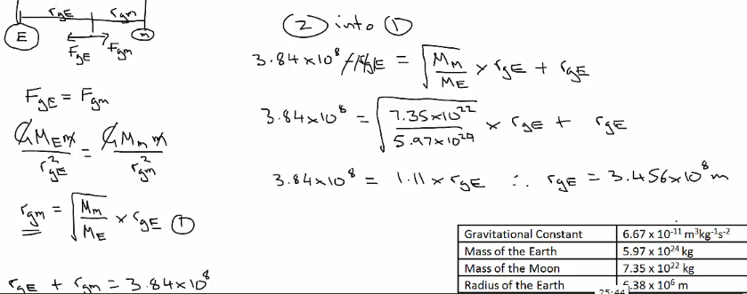
To analyse gravitational attraction
Content Development
  At what altitude above the Earth could an astronaut sit between the Earth and the Moon so that he would not accelerate towards either.
Notes:
Fge = Fgm
Gm(e)m/r(e)^2 = Gm(m)m/r(m)^2 =
r(m) = sqrt(m(m) / m(e)) * r(e)
Distance from Earth-> astronaut + Distance from astronaut -> moon = Distance from earth to moon
r(m) + r(e) = 3.84x10^8

Slide 23
To calculate gravitational attraction between objects
Success Criteria
I can calculate gravitational attraction between objects
I can calculate acceleration due to gravity

Slide 24

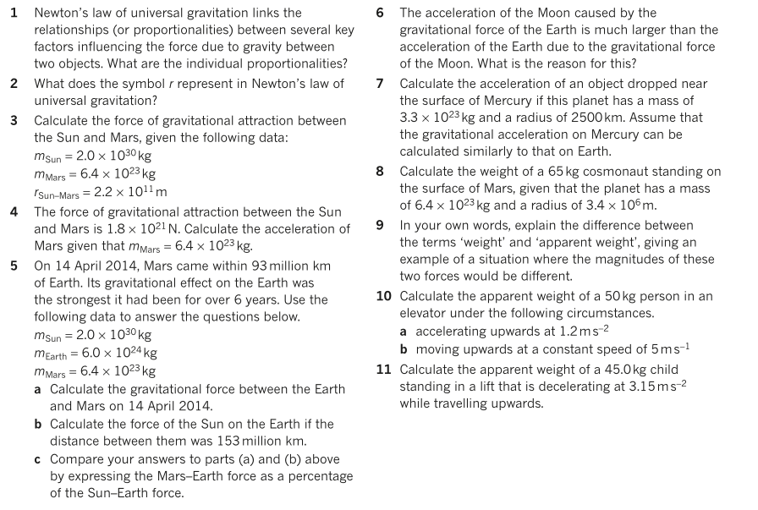
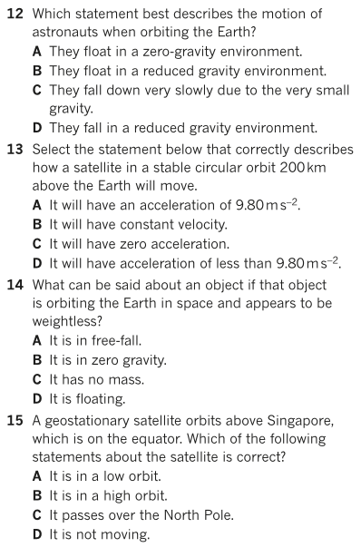
To analyse gravitational attraction
Additional Study
  Future content required for these questions

